Slide 1
UNIT 1

Slide 2
Introduction
Sun Microsystems released the first version of Java in early 1996
Whole platform, with a huge library, containing lots of reusable code, and an execution environment that provides services such as security, portability across operating systems, and automatic garbage collection

Slide 3
The Java Buzzwords
1. Simple
No need for header files, files, pointer arithmetic (or even a pointer syntax), structures, unions, operator overloading, virtual base classes, and so on.
Software that can run stand-alone in small machines.
2. Object-Oriented
Focuses on the data (= objects) and on the interfaces to that object
Difference between Java and C++ lies in multiple inheritance, which Java has replaced with the simpler concept of interfaces
3. Network-Savvy
Java has an extensive library of routines for coping with TCP/IP protocols like HTTP and FTP.
Java applications can open and access objects across the Net via URLs with the same ease as when accessing a local file system.

Slide 4
The Java Buzzwords…
4. Robust
Programs must be reliable in a variety of ways.
Java puts a lot of emphasis on early checking for possible problems, later dynamic (runtime) checking, and eliminating situations that are error-prone.
The single biggest difference between Java and C/C++ is that Java has a pointer model that eliminates the possibility of overwriting memory and corrupting data
5. Secure
Java enables the construction of virus-free, tamper-free systems

Slide 5
The Java Buzzwords…
6. Architecture-Neutral
The compiled code is executable on many processors, given the presence of the Java runtime system
The Java compiler does this by generating byte code instructions which have nothing to do with a particular computer architecture.
They are designed to be easy to interpret on any machine and easily translated into native machine code.
7. Portable
Unlike C and C++, there are no “implementation-dependent” aspects of the specification.
Eg: int in Java is always a 32-bit integer.
In C/C++, int can mean a 16-bit integer, a 32-bit integer, or any other size that the compiler vendor likes.
Having a fixed size for number types eliminates a major porting headache.
Binary data is stored and transmitted in a fixed format, eliminating confusion about byte ordering.
Strings are saved in a standard Unicode format.

Slide 6
The Java Buzzwords…
8. Interpreted
The Java interpreter can execute Java byte codes directly on any machine to which the interpreter has been ported
9. High-Performance
The byte codes can be translated on the fly (at runtime) into machine code for the particular CPU the application is running on.
10. Multithreaded
Threads in Java can take advantage of multiprocessor systems if the base operating system does so.
11. Dynamic
Libraries can freely add new methods and instance variables without any effect on their clients

Slide 7
Fundamental Programming Structures in Java

Slide 8
A Simple Java Program
public class ClassName
{
public static void main(String[] args)
{ program statements
}
}
public class FirstSample
{
public static void main(String[] args)
{
System.out.println(“Welcome!'");
}
}

Slide 9
Fundamentals of java program
Java is case sensitive. Eg: Main instead of main will cause error.
keyword public is called an access modifier
keyword class reminds you that everything in a Java program lives inside a class
Following the keyword class is the name of the class
The rules for class names in Java are
  Names must begin with a letter, and after that, they can have any combination of letters and digits.
  The length is unlimited.
  You cannot use a Java reserved word (such as public or class) for a class name

Slide 10
Fundamentals of java program…
Class names are nouns that start with an uppercase letter.
If a name consists of multiple words, use an initial uppercase letter in each of the words. (“camel case” or, self-referentially, “CamelCase”.)
The file name for the source code should be the same as the name of the public class, with the extension .java appended
Eg: FirstSample.java. (don’t use firstsample.java.)
To run a compiled program, the Java virtual machine always starts execution with the code in the main method in the class you indicate.

Slide 11
Fundamentals of java program…
The main method must be declared public
The static keyword indicates that a member variable or method can be accessed without requiring an instantiation of the class to which it belongs.
It means that you can call a method, even if you have never created the object to which it belongs.
In Java, the code for any method must be started by an opening brace { and ended by a closing brace }
System.out object calls its println method
Java uses the general syntax
object.method(parameters)

Slide 12
Fundamentals of java program…
Methods in Java, like functions in any programming language, can use zero, one, or more parameters (some programmers call them arguments).
Even if a method takes no parameters, you must still use empty parentheses.
For example, println method with no parameters just prints a blank line.
System.out.println();
System.out also has a print method that doesn’t add a newline character to the output.
For example, System.out.print("Hello") prints Hello without a newline. The next
output appears immediately after the letter o.

Slide 13
Comments
The most common form is a //
System.out.println("Hello!'"); // is this too cute?
or you can use the /* and */ comment delimiters that let you block off a longer comment.
A third kind of comment can be used to generate documentation automatically.
This comment uses a /** to start and a */ to end.

Slide 14
Data Types
Java is a strongly typed language.
There are eight primitive types in Java.
Four integer types
Two floating-point number types
one is the character type char, used for code units in the Unicode encoding scheme
one is a boolean type for truth values.

Slide 15
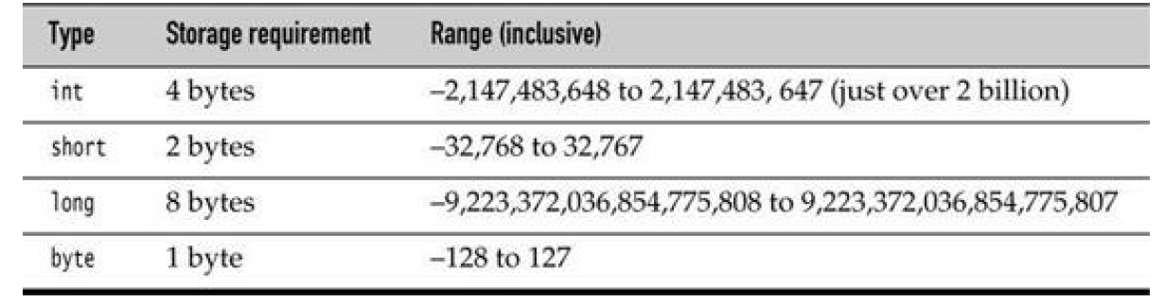
Integer Types
The integer types are for numbers without fractional parts. Negative values are allowed.
Java does not have any unsigned types

Slide 16
Integer Types
Long integer numbers have a suffix L (for example, 4000000000L).
Hexadecimal numbers have a prefix 0x (for example, 0xCAFE).
Octal numbers have a prefix 0. For example, 010 is 8.

Slide 17
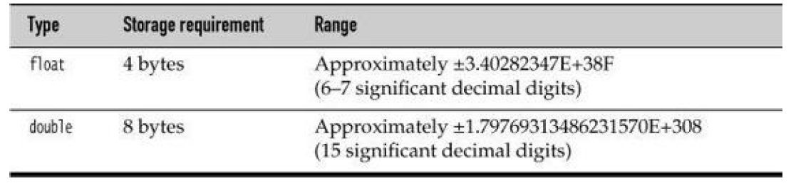
Floating-Point Types
The floating-point types denote numbers with fractional parts.

Slide 18
Floating-Point Types…
Double refers to the numbers that have twice the precision of the float type double-precision numbers
Float is used in rare situations.
Numbers of type float have a suffix F (for example, 3.14F
Floating-point numbers without an F suffix (Eg: 3.14) are always considered to be of type double.
D suffix can be used optionally for double precision numbers (for example, 3.14D).

Slide 19
Floating-Point Types…
There are three special floating-point values to denote overflows and errors:
• Positive infinity
• Negative infinity
• NaN (not a number)
For example, the result of dividing a positive number by 0 is positive infinity.
Computing 0/0 or the square root of a negative number yields NaN.
The constants Double.POSITIVE_INFINITY, Double.NEGATIVE_INFINITY, and Double.NaN represent these special values, but they are rarely used in practice.

Slide 20
The char Type
Used to describe individual characters - character constants
Eg: 'A' is a character constant with value 65
It is different from "A", a string containing a single character
Unicode code units can be expressed as hexadecimal values that run from \u0000 to \uFFFF.
Eg: \u2122 is the trademark symbol (™) and \u03C0 is the Greek letter pi (π).

Slide 21
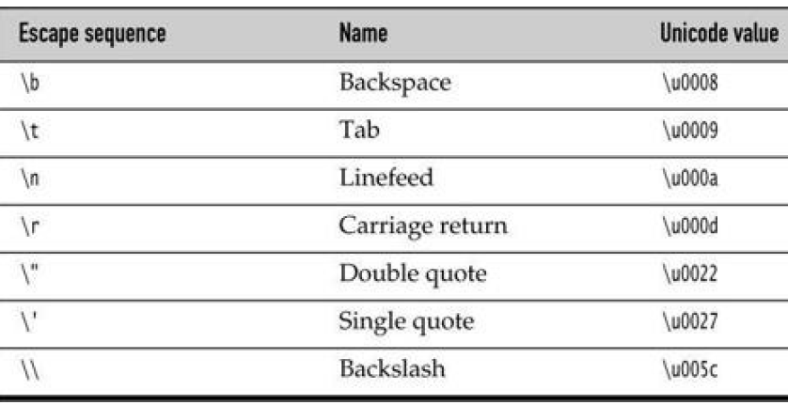
Escape Sequences for Special Characters

Slide 22
Unicode encoding scheme
Before Unicode, there were many different standards: ASCII in the United States, ISO 8859-1 for Western European languages, KOI-8 for Russian, GB18030 and BIG-5 for Chinese, and so on.
This causes two problems.
A particular code value corresponds to different letters in the different encoding schemes.
Moreover, the encodings for languages with large character sets have variable length.
Some common characters are encoded as single bytes, others require two or more bytes.
In Java, the char type describes a code unit in the UTF-16 encoding.

Slide 23
Unicode encoding scheme…
Unicode was designed to solve the following problems.
During 1980s, a fixed 2-byte code was more than sufficient to encode all characters used in all languages in the world.
In 1991, Unicode 1.0 was released, using slightly less than half of the available 65,536 code values.
Java was designed from the ground up to use 16-bit Unicode characters, which was a major advance over other programming languages that used 8-bit characters.

Slide 24
The boolean Type
The boolean type has two values, false and true.
It is used for evaluating logical conditions.
You cannot convert between integers and boolean values.

Slide 25
Variables
In Java, every variable has a type. Y
A variable is declared by placing the type first, followed by the name of the variable.
Eg: double salary;
int vacationDays;
long earthPopulation;
boolean done;
The semicolon is necessary because a declaration is a complete Java statement.

Slide 26
A variable name must begin with a letter and must be a sequence of letters or digits.
Case sensitive
Length of a variable is unlimited.
As names are case sensitive, many programmers then give the variable the same name as the type.
For example
Box box; // "Box" is the type and "box" is the variable name

Slide 27
Initializing Variables
After the declaration, a variable must be initialized it by means of an assignment statement
We can never use the value of an uninitialized variable. For example, the Java compiler will issue the following error:
int vacationDays;
System.out.println(vacationDays); // ERROR--variable not initialized
int vacationDays;
vacationDays = 12;
You can both declare and initialize a variable on the same line. For example:
int vacationDays = 12;

Slide 28
In Java you can put declarations anywhere in your code
double salary = 65000.0;
System.out.println(salary);
int vacationDays = 12; // OK to declare a variable here

Slide 29
Constants
In Java, you use the keyword final to denote a constant.
Example : public class Constants
{
public static void main(String[] args)
{
final double CM_PER_INCH = 2.54;
double paperWidth = 8.5;
double paperHeight = 11;
System.out.println("Paper size in centimeters: "
+ paperWidth * CM_PER_INCH + " by " + paperHeight * CM_PER_INCH);
}
}

Slide 30
Constants
In Java a constant can be created so that it’s available to multiple methods inside a single class.
These are usually called class constants.
public class Constants2
{
public static final double CM_PER_INCH = 2.54;
public static void main(String[] args)
{
double paperWidth = 8.5;
double paperHeight = 11;
System.out.println("Paper size in centimeters: "
+ paperWidth * CM_PER_INCH + " by " + paperHeight * CM_PER_INCH);
}
}

Slide 31
Operators
Arithmetic operators +, -, *, / are used in Java for addition, subtraction, multiplication, and division.
The / operator denotes integer division if both arguments are integers, and floating point division otherwise.
Integer remainder (sometimes called modulus) is denoted by %.
example, 15 / 2 is 7, 15 % 2 is 1 and
15.0 / 2 is 7.5.

Slide 32
Integer division by 0 raises an exception, whereas floating-point division by 0 yields an infinite or NaN result.
Shortcut can be used for binary arithmetic operators in an assignment. For example,
x += 4; is equivalent to x = x + 4;

Slide 33
Increment and Decrement Operators
n++ adds 1 to the current value of the variable n, and n-- subtracts 1 from it.
int n = 12;
n++; changes n to 13.
Since these operators change the value of a variable, they cannot be applied to numbers themselves.
For example, 4++ is not a legal statement.
There are actually two forms of these operators;
Postfix form in which operator is placed after the operand. n++
There is also a prefix form, ++n.
Both change the value of the variable by 1.

Slide 34
The difference between the two only appears when they are used inside expressions.
The prefix form does the addition first; the postfix form evaluates to the old value of the variable.
int m = 7;
int n = 7;
int a = 2 * ++m; // now a is 16, m is 8
int b = 2 * n++; // now b is 14, n is 8

Slide 35
Relational and boolean Operators
== is used for equality
Example, the value of 3 == 7 is false.
!= is used for inequality. For example, the value of
3 != 7 is true.
< (less than), > (greater than), <= (less than or equal), and >= (greater than or equal) operators are also available in java.

Slide 36
&& → logical “and” operator and
|| → logical “or” operator.
The && and || operators are evaluated in “short circuit” fashion:
The second argument is not evaluated if the first argument already determines the value.
expression1 && expression2
if the truth value of the first expression has been determined to be false, then it is impossible for the result to be true.
Thus, the value for the second expression is not calculated.

Slide 37
Java supports the ternary ?: operator that is occasionally useful.
condition ? expression1 : expression2
evaluates to the first expression if the condition is true, to the second expression otherwise.
Example x < y ? x : y
gives the smaller of x and y.

Slide 38
Bitwise Operators
The bitwise operators are
& (“and”)
| (“or”)
^ (“xor”)
~ (“not”)
>> (Shift right)
<< (Shift left)
1001
0011

Slide 39
Mathematical Functions and Constants
The Math class contains mathematical functions
To take the square root of a number, use the sqrt method:
double x = 4;
double y = Math.sqrt(x);
System.out.println(y); // prints 2.0
There is a difference between the println method and the sqrt method.
The println method operates on an object, System.out, defined in the System class.
But the sqrt method in the Math class does not operate on any object.
Such a method is called a static method.

Slide 40
double y = Math.pow(x, a);
The Math class supplies the usual trigonometric functions:
Math.sin, Math.cos, Math.tan, Math.atan, Math.atan2
and the exponential function with its inverse, the natural logarithm, as well as the decimal logarithm:
Math.exp, Math.log, Math.log10
Finally, two constants denote the closest possible approximations to the mathematical constants π and e:
Math.PI, Math.E
import static java.lang.Math.*;

Slide 41
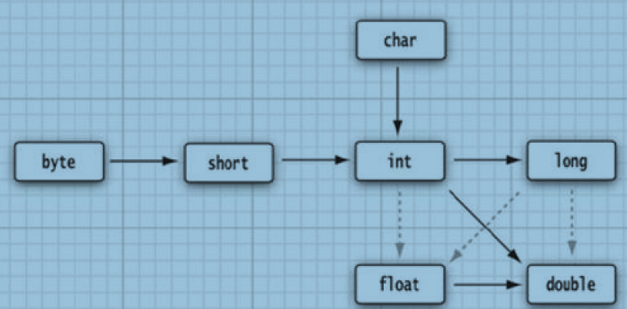
Conversions between Numeric Types
Six Solid arrows denote conversions without information loss.
Three dotted arrows denote conversions that may lose precision.

Slide 42
A larger integer has more digits than the float type can represent.
When the integer is converted to a float, the resulting value has the correct magnitude, but it may lose some precision.
int n = 123456789;
float f = n; // f is 1.23456792E8
When two values in different types are combined with a binary operator, both operands are converted to a common type before the operation is performed.

Slide 43
If either of the operands is of type double, the other one will be converted to a double.
Otherwise, if either of the operands is of type float, the other one will be converted to a float.
Otherwise, if either of the operands is of type long, the other one will be converted to a long.
Otherwise, both operands will be converted to an int.

Slide 44
Type Casting
Conversions in which loss of information is possible are done by means of casts.
The syntax for casting is to give the target type in parentheses, followed by the variable name. For example:
double x = 9.997;
int nx = (int) x;
nx = 9 because casting a floating-point value to an integer discards the fractional part.
To round a floating-point number to the nearest integer use the Math.round method:
double x = 9.997;
int nx = (int) Math.round(x);
nx = 10. You still need to use the cast (int) when you call round.
The reason is that the return value of the round method is a long, and a long can only be assigned to an int with an explicit cast because there is the possibility of information loss.

Slide 45
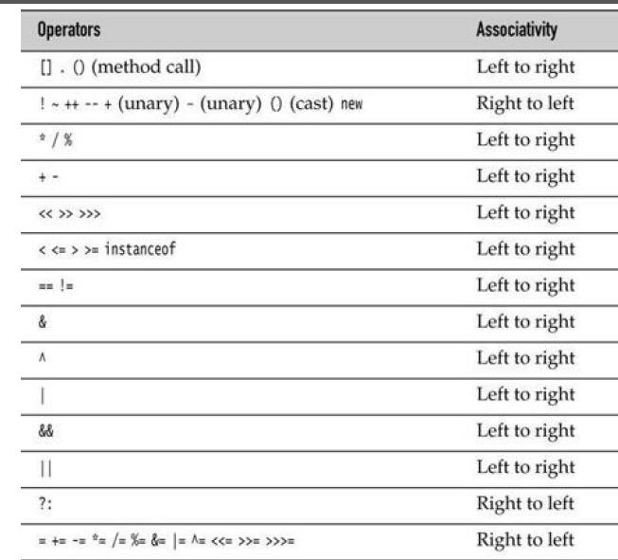
Operator Precedence

Slide 46
Enumerated Types
Sometimes, a variable should only hold a restricted set of values.
For example, clothes may be in four sizes: small, medium, large, and extra large.
It can be encoded as integers 1, 2, 3, 4, or characters S, M, L, and X.
For these types we can define our own enumerated type
An enumerated type has a finite number of named values.
Eg:enum Size { SMALL, MEDIUM, LARGE, EXTRA_LARGE };
Size s = Size.MEDIUM;
A variable of type Size can hold only one of the values listed in the type declaration, or the special value null that indicates that the variable is not set to any value at all.

Slide 47
Strings
Java strings are sequences of Unicode characters.
Java does not have a built-in string type.
Instead, the standard Java library contains a predefined class called, String.
Each quoted string is an instance of the String class:
String e = “ "; // an empty string
String greeting = "Hello";

Slide 48
Substrings
A substring can be extracted from a larger string with the substring method of the String class.
For example, String greeting = "Hello";
String s = greeting.substring(0, 3); "Hel".
Computing the length of the substring is easy.
The string s.substring(a, b) always has length b - a.
For example, the substring "Hel" has length 3 – 0 = 3.

Slide 49
Concatenation
Java uses + to join (concatenate) two strings.
String first = “Hai";
String second = “Hello";
String message = first + second;
This code sets the variable message to the string “HaiHello".
When you concatenate a string with a value that is not a string, the latter is converted to a string.
Eg: int age = 13;
String rating = "PG" + age; now rating = "PG13".
This feature is commonly used in output statements. For example,
System.out.println("The answer is " + answer);

Slide 50
Strings Are Immutable
When a string is allowed to change it is mutable, otherwise it is immutable.
In java, String class does not have a direct method to change the characters of a string.
But using substring method the characters of a string variable can be changed.
Eg: greeting=“Hello”;
greeting = greeting.substring(0, 3) + "p!";
This changes “Hello” to “Help!”

Slide 51
Testing Strings for Equality
To test whether two strings are equal, use the equals method.
s.equals(t)
returns true if the strings s and t are equal, false otherwise.
s and t can be string variables or string constants. "Hello".equals(greeting)
To test whether two strings are identical except for the upper/lowercase letter distinction, use the equalsIgnoreCase method.
"Hello".equalsIgnoreCase("hello")

Slide 52
Do not use the == operator to test whether two strings are equal!
It only determines whether or not the strings are stored in the same location.
If strings are in the same location, they must be equal.
String greeting = "Hello";
if (greeting == "Hello") . . .
The Java method compareTo is the exact analog to strcmp in C.
if (greeting.compareTo("Hello") == 0) . . .
but it seems clearer to use equals instead.

Slide 53
Empty and Null Strings
The empty string "" is a string of length 0.
To test whether a string is empty use the condition
if (str.length() == 0)
or
if (str.equals(""))
A String variable can also hold a special value, called null, that indicates that no object is currently associated with the variable.
To test whether a string is null, use the condition
if (str == null)
To test that a string is neither null nor empty
if (str != null && str.length() != 0)

Slide 54
Code Points and Code Units
The char data type is a code unit for representing Unicode code points in the UTF-16 encoding.
The length method yields the number of code units required for a given string in the UTF-16 encoding.
String greeting = "Hello";
int n = greeting.length(); // is 5.
s.charAt(n) returns the character at position n, where n is between 0 and s.length() – 1
char first = greeting.charAt(0); // first is 'H'
char last = greeting.charAt(4); // last is 'o‘

Slide 55
The String API (Application Programming Interface)
The String class in Java contains more than 50 methods.
Each API note starts with the name of a class such as
java.lang.String (package name java.lang)

Slide 56
java.lang.String
char charAt(int index)
returns the code unit at the specified location.
int codePointAt(int index)
returns the code point that starts or ends at the specified location.
int offsetByCodePoints(int startIndex, int cpCount)
returns the index of the code point that is cpCount code points away from the code point at startIndex.
int compareTo(String other)
returns a negative value if the string comes before other in dictionary order, a positive value if the string comes after other in dictionary order, or 0 if the strings are equal.

Slide 57
boolean endsWith(String suffix)
returns true if the string ends with suffix.
boolean equals(Object other)
returns true if the string equals other.
boolean equalsIgnoreCase(String other)
returns true if the string equals other, except for upper/lowercase distinction.
int indexOf(String str)
int indexOf(String str, int fromIndex)
returns the start of the first substring equal to the string str, starting at index 0 or at fromIndex, or -1 if str does not occur in this string.

Slide 58
int lastIndexOf(String str)
int lastIndexOf(String str, int fromIndex)
returns the start of the last substring equal to the string str, starting at the end of the string or at fromIndex.
int length() returns the length of the string.
String replace(CharSequence oldString, CharSequence newString)
returns a new string that is obtained by replacing all substrings matching oldString in the string with the string newString.
boolean startsWith(String prefix)
returns true if the string begins with prefix.
String substring(int beginIndex)
String substring(int beginIndex, int endIndex)
returns a new string consisting of all code units from beginIndex until the end of the string or until endIndex - 1.

Slide 59
String toLowerCase()
returns a new string containing all characters in the original string, with uppercase characters converted to lowercase.
String toUpperCase()
returns a new string containing all characters in the original string, with lowercase characters converted to uppercase.
String trim()
returns a new string by eliminating all leading and trailing spaces in the original string.

Slide 60
Building Strings
Sometimes, we need to build up strings from shorter strings, such as keystrokes or words from a file.
It would be inefficient to use string concatenation for this purpose.
Every time you concatenate strings, a new String object is constructed.
This is time-consuming and wastes memory.
Using the StringBuilder class avoids this problem.
First, construct an empty string builder:
StringBuilder builder = new StringBuilder();
Each time you need to add another part, call the append method.
builder.append(ch); // appends a single character
builder.append(str); // appends a string
When you are done building the string, call the toString method.
You will get a String object with the character sequence contained in the builder.
String completedString = builder.toString();

Slide 61
void setCharAt(int i, char c)
sets the ith code unit to c.
StringBuilder insert(int offset, String str)
inserts a string at position offset and returns this.
StringBuilder insert(int offset, char c)
inserts a code unit at position offset and returns this.
StringBuilder delete(int startIndex, int endIndex)
deletes the code units with offsets startIndex to endIndex - 1 and returns this.
String toString()
returns a string with the same data as the builder or buffer contents.

Slide 62
//StringInitialization
public class MyStringInitialization {
public static void main(String a[]){
String abc = "This is a string object";
String bcd = new String("this is also string object");
char[] c = {'a','b','c','d'};
String cdf = new String(c);
String junk = abc+" This is another String object";
}
}

Slide 63
// Comparing strings
public class MyStringEquals {
public static void main(String a[]){
String x = "JUNK";
String y = "junk";
if(x.equals(y)){
System.out.println("Both strings are equal.");
} else {
System.out.println("Both strings are not equal.");
}
if(x.equalsIgnoreCase(y)){
System.out.println("Both strings are equal.");
} else {
System.out.println("Both strings are not equal.");
}
}
}
Output
Both strings are not equal.
Both strings are equal.

Slide 64
//Replacing Strings
public class MyStringReplace {
public static void main(String a[]){
String str = "This is an example string";
System.out.println("Replace char 's' with 'o':“
+str.replace('s', 'o'));
System.out.println("Replace first occurance of string\"is\" with \"ui\":” +str.replaceFirst("is", "ui"));
System.out.println("Replacing \"is\" every where with \"no\":"
+str.replaceAll("is", "no"));
}
}
Output
Replace char 's' with 'o':Thio io an example otring
Replace first occurance of string"is" with "ui":Thui is an example string
Replacing "is" every where with "no":Thno no an example string

Slide 65
// Index Of Example
public class MyStringIndexOf {
public static void main(String[] a){
String str = "Use this string for testing this";
System.out.println("Basic indexOf() example");
System.out.println("Char 's' at first occurance: "+str.indexOf('s'));
System.out.println("String \"this\" at first occurance: "+str.indexOf("this"));
System.out.println("First occurance of char 's' from 4th index onwards :
+str.indexOf('s',4));
System.out.println("First occurance of String \"this\" from 6th index onwards: “ +str.indexOf("this",6));
}
}
Output
Basic indexOf() example
Char 's' at first occurance: 1
String "this" at first occurance: 4
First occurance of char 's' from 4th index onwards : 7
First occurance of String "this" from 6th index onwards: 28

Slide 66
// Ends with example
public class MyStringEnd {
public static void main(String a[]){
String str = "This is a java string example";
if(str.endsWith("example")){
System.out.println("This String ends with example");
} else {
System.out.println("This String is not ending with example");
}
if(str.endsWith("java")){
System.out.println("This String ends with java");
} else {
System.out.println("This String is not ending with java");
}
}
}
Output
This String ends with example
This String is not ending with java

Slide 67
Input and Output
Reading Input
Reading from the “standard input stream” System.in isn’t simple like System.out.
To read console input, you first construct a Scanner that is attached to System.in:
Scanner in = new Scanner(System.in);
Methods of the Scanner class to read input. For example, nextLine method reads a line of input.
System.out.print("What is your name? ");
String name = in.nextLine();

Slide 68
Reading Input
To read a single word
String firstName = in.next();
To read an integer, use the nextInt method.
System.out.print("How old are you? ");
int age = in.nextInt();
Similarly, the nextDouble method reads the next floating-point number.

Slide 69
import java.util.*;
public class InputTest
{
public static void main(String[] args)
{
Scanner in = new Scanner(System.in);
System.out.print("What is your name? ");
String name = in.nextLine();
System.out.print("How old are you? ");
int age = in.nextInt();
System.out.println("Hello, " + name + ". Next year, you'll be " +(age + 1));
}
}

Slide 70
import java.util.Scanner;
class ScannerTest{
public static void main(String args[]){
Scanner sc=new Scanner(System.in);
System.out.println("Enter your rollno");
int rollno=sc.nextInt();
System.out.println("Enter your name");
String name=sc.next();
System.out.println("Enter your fee");
double fee=sc.nextDouble();
System.out.println("Rollno:"+rollno+" name:"+name+" fee:"+fee); sc.close();
}
}

Slide 71
java.util.Scanner 5.0
Scanner(InputStream in)
constructs a Scanner object from the given input stream.
String nextLine()
reads the next line of input.
String next()
reads the next word of input (delimited by whitespace).
int nextInt()
double nextDouble()
reads and converts the next character sequence that represents an integer or floating-point number
boolean hasNext()
tests whether there is another word in the input.
boolean hasNextInt()
boolean hasNextDouble()
tests whether the next character sequence represents an integer or floating-point number.

Slide 72
import java.util.*;
public class Retirement
{
public static void main(String[] args)
{
Scanner in = new Scanner(System.in);
System.out.print(“money needed to retire? ");
double target = in.nextDouble();
System.out.print(“money contributed every year?");
double payment = in.nextDouble();
System.out.print("Interest rate in %: ");
double interestRate = in.nextDouble();
double balance = 0;
int years = 0;
while (balance < target)
{
balance += payment;
double interest = balance * interestRate / 100;
balance += interest;
years++;
}
System.out.println("You can retire in “+years+“years.");
}
}

Slide 73
java.lang.System
static Console console() 6
returns a Console object for interacting with the user through a console window if such an interaction is possible, null otherwise.
A Console object is available for any program that is launched in a console window. Otherwise, the availability is system-dependent.
java.io.Console
static char[] readPassword(String prompt, Object... args)
static String readLine(String prompt, Object... args)
displays the prompt and reads the user input until the end of the input line.
The args parameters can be used to supply formatting arguments.

Slide 74
Formatting Output
System.out.print(x) will print x with the maximum number of non-zero digits if x is of double type.
Eg: double x = 10000.0 / 3.0;
System.out.print(x); 3333.3333333333335
System.out.printf("%8.2f", x);
prints x with a field width of 8 characters and a precision of 2 characters.
That is, the printout contains a leading space and the seven characters
3333.33

Slide 75
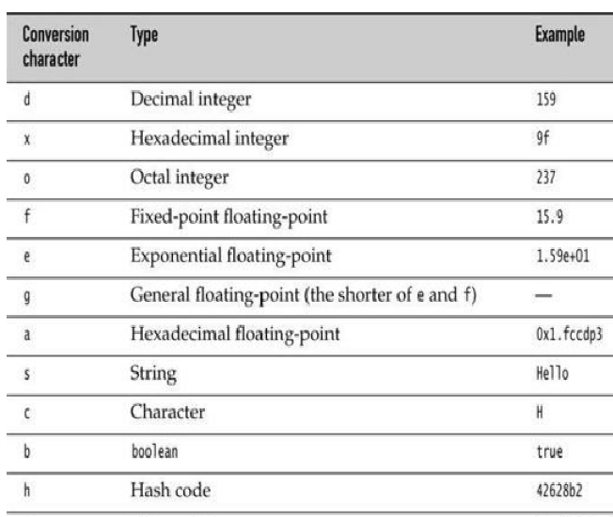

Slide 76
In addition, you can specify flags that control the appearance of the formatted output.
For example, the comma flag adds group separators. That is, System.out.printf("%,.2f", 10000.0 / 3.0);
Prints 3,333.33
You can use multiple flags, for example "%,(.2f" to use group separators and enclose negative numbers in parentheses.

Slide 77
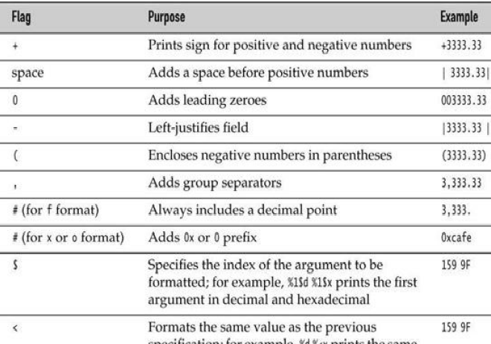

Slide 78
Date Type
Use a twoletter format, starting with t and ending in one of the letters given in Table
for example,
System.out.printf("%tc", new Date());
Mon Feb 09 18:05:19 PST 2004

Slide 79
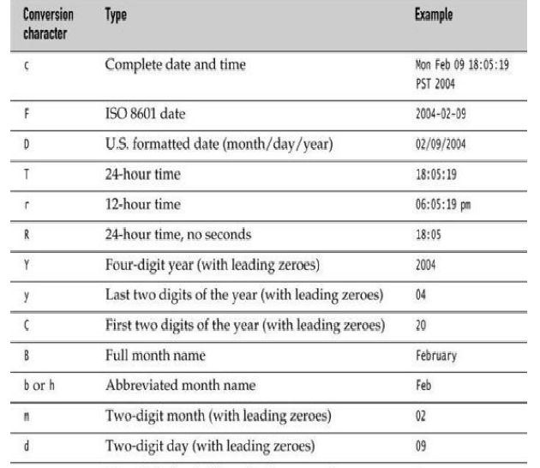

Slide 80


Slide 81
Control Flow
Java, supports both conditional statements and loops to determine control flow.
There is no goto, but there is a “labeled” version of break that you can use to break out of a nested loop (where, in C, you perhaps would have used a goto).
Finally, there is a variant of the for loop that has no analog in C or C++.

Slide 82
Block Scope
A block or compound statement is any number of simple Java statements surrounded by a pair of braces.
Blocks define the scope of your variables.
A block can be nested inside another block.
public static void main(String[] args)
{
int n;
. . .
{
int k;
. . .
} // k is only defined up to here
}

Slide 83
you can not declare identically named variables in two nested blocks.
For example, the following is an error and will not compile:
public static void main(String[] args)
{
int n;
. . .
{
int k;
int n; // ERROR--can't redefine n in inner block
. . .
}
}

Slide 84
Determinate Loops
The for loop is a general construct to support iteration controlled by a counter or similar variable that is updated after every iteration.
The following loop prints the numbers from 1 to 10 on the screen.
Eg 1: for (int i = 1; i <= 10; i++)
System.out.println(i);
Eg 2: for (int i = 10; i > 0; i--)
System.out.println("Counting down . . . " + i);

Slide 85
When you declare a variable in the for statement, the scope of that variable extends until the end of the body of the for loop.
for (int i = 1; i <= 10; i++)
{
. . .
}
// i no longer defined here
In particular, if you define a variable inside a for statement, you cannot use its value outside the loop.
int i;
for (i = 1; i <= 10; i++)
{
. . .
}
// i is still defined here

Slide 86
You can define variables with the same name in separate for loops:
for (int i = 1; i <= 10; i++)
{
. . .
}
.. .
for (int i = 11; i <= 20; i++) // OK to define another variable named i
{
. . .
}

Slide 87
Conditional Statements
The conditional statement in Java has the form
if (condition) statement
The condition must be surrounded by parentheses.
if (yourSales >= target)
{
performance = "Satisfactory";
bonus = 100;
}
if (condition) statement1 else statement2

Slide 88
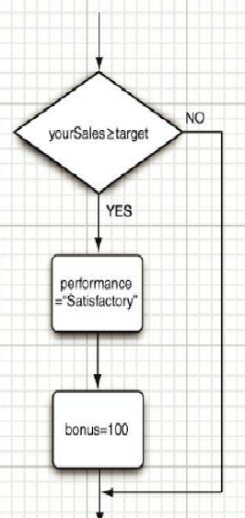
Flowchart for If Statement

Slide 89
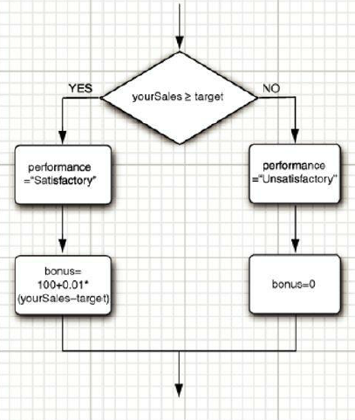
Flowchart for If… Else… Statement

Slide 90
If… else…
The else part is always optional.
An else groups with the closest if.
In the statement
if (x <= 0) if (x == 0) sign = 0; else sign = -1;
the else belongs to the second if.
Of course, it is a good idea to use braces to clarify this code:
if (x <= 0) { if (x == 0) sign = 0; else sign = -1; }

Slide 91
Repeated if . . . else if . . . alternatives are common
if (yourSales >= 2 * target)
{
performance = "Excellent";
bonus = 1000;
}else if (yourSales >= 1.5 * target)
{
performance = "Fine";
bonus = 500;
}else if (yourSales >= target)
{
performance = "Satisfactory";
bonus = 100;
}else
{
System.out.println("You're fired");
}

Slide 92
Loops
The while loop executes a statement (which may be a block statement) while a condition is true.
The general form is
while (condition) statement
The while loop will never execute if the condition is false at the outset
  int limit=20;
  int sum=0;
  int i=1;
  while (i <=limit)
  { sum+=i++; }
  System.out.println(“sum=“ + sum);

Slide 93
Do… While
A while loop tests at the top.
Therefore, the code in the block may never be executed if the condition initially fails.
To execute the block at least once, you will need to move the test to the bottom, using the do/while loop. Its syntax looks like this:
do statement while (condition);
This loop executes the statement (which is typically a block) and only then tests the condition.
If it’s true, it repeats the statement and retests the condition, and so on.

Slide 94
int limit=20;
int sum=0;
int i=1;
do{
sum+=i;
i++;
}while(i<=limit);
System.out.println(“sum=“+sum);

Slide 95
Multiple Selections—The switch Statement
Scanner in = new Scanner(System.in);
System.out.print("Select an option (1, 2, 3, 4)");
int choice = in.nextInt();
switch (choice)
{
case 1: . . .
break;
case 2: . . .
break;
case 3: . . .
break;
case 4: . . .
break;
default:
. . .
break;
}
The if/else construct will be confusing when you have to deal with multiple selections with many alternatives. You can use switch statement
For example, if you set up a menuing system with four alternatives

Slide 96
A case label can be
  A constant expression of type char, byte, short, or int (or their corresponding wrapper classes Character, Byte, Short, and Integer)
  An enumerated constant
  Starting with Java SE 7, a string literal
For example,
  String input = . . .;
  switch (input.toLowerCase())
  {
  case "yes": // OK since Java SE 7
  . . .
  break;
  . . .
  }
Size sz = . . .;
switch (sz)
{
case SMALL: // no need to use Size.SMALL
. . .
break;
. . .
}

Slide 97
Statements That Break Control Flow
Java does not support goto statement.
Instead of that it has a labelled break statement.
The same break statement that you use to exit a switch can also be used to break out of a loop. For example:
  while (years <= 100)
  {
  balance += payment;
  double interest = balance * interestRate / 100;
  balance += interest;
  if (balance >= goal) break;
  years++;
  }

Slide 98
The labeled break statement lets you break out of multiple nested loops.
Occasionally something weird happens inside a deeply nested loop.
In that case, you may want to break completely out of all the nested loops.
It is inconvenient to program that simply by adding extra conditions to the various loop tests.

Slide 99
Scanner in = new Scanner(System.in);
int n;
read_data:
while (. . .) // this loop statement is tagged with the label
{
. . .
for (. . .) // this inner loop is not labeled
{
System.out.print("Enter a number >= 0: ");
n = in.nextInt();
if (n < 0) // should never happen—can't go on
break read_data; // break out of read_data loop
. . .
}
} // this statement is executed immediately after the labeled break
if (n < 0) // check for bad situation
{ // deal with bad situation
}else
{ // carry out normal processing }

Slide 100
The continue statement transfers control to the header of the innermost enclosing loop.
    Scanner in = new Scanner(System.in);
    while (sum < goal)
    {
    System.out.print("Enter a number: ");
    n = in.nextInt();
    if (n < 0) continue;
    sum += n; // not executed if n < 0
    }
If n < 0, then the continue statement jumps immediately to the loop header, skipping the remainder of the current iteration.

Slide 101
If the continue statement is used in a for loop, it jumps to the “update” part of the for loop.
  for (count = 1; count <= 100; count++)
  {
  System.out.print("Enter a number, -1 to quit: ");
  n = in.nextInt();
  if (n < 0) continue;
  sum += n; // not executed if n < 0
  }
If n < 0, then the continue statement jumps to the count++ statement.

Slide 102
If the continue statement is used in a for loop, it jumps to the “update” part of the for loop.
  for (count = 1; count <= 100; count++)
  {
  System.out.print("Enter a number, -1 to quit: ");
  n = in.nextInt();
  if (n < 0) continue;
  sum += n; // not executed if n < 0
  }
If n < 0, then the continue statement jumps to the count++ statement.
There is also a labeled form of the continue statement that jumps to the header of the loop with the matching label.

Slide 103
Big Numbers
If the precision of the basic integer and floating-point types is not sufficient, it can be turned to a couple of handy classes in the java.math package: BigInteger and BigDecimal.
These are classes for manipulating numbers with an arbitrarily long sequence of digits.
The BigInteger class implements arbitrary-precision integer arithmetic, and BigDecimal does the same for floating-point numbers.
Using the static valueOf method an ordinary number can be turned into a big number:
BigInteger a = BigInteger.valueOf(100);

Slide 104
you cannot use the familiar mathematical operators such as + and * to combine big numbers.
Instead, you must use methods such as add and multiply in the big number classes.
BigInteger c = a.add(b); // c = a + b
BigInteger d = c.multiply(b.add (BigInteger.valueOf (2))); // d = c * (b + 2)

Slide 105
java.math.BigInteger 1.1
• BigInteger add(BigInteger other)
• BigInteger subtract(BigInteger other)
• BigInteger multiply(BigInteger other)
• BigInteger divide(BigInteger other)
• BigInteger mod(BigInteger other)
returns the sum, difference, product, quotient, and remainder of this big integer and other.
• int compareTo(BigInteger other)
returns 0 if this big integer equals other, a negative result if this big integer is less than other, and a positive result otherwise.
• static BigInteger valueOf(long x)
returns a big integer whose value equals x.

Slide 106
java.math.BigDecimal 1.1
• BigDecimal add(BigDecimal other)
• BigDecimal subtract(BigDecimal other)
• BigDecimal multiply(BigDecimal other)
• BigDecimal divide(BigDecimal other, RoundingMode mode) 5.0
To compute the quotient, you must supply a rounding mode.
• int compareTo(BigDecimal other)
returns 0 if this big decimal equals other, a negative result if this big decimal is less than other, and a positive result otherwise.
• static BigDecimal valueOf(long x)
• static BigDecimal valueOf(long x, int scale)
returns a big decimal whose value equals x or x / 10scale.

Slide 107
Arrays
An array is a data structure that stores a collection of values of the same type.
You access each individual value through an integer index.
a[i] is the ith integer in the array.
Declaration
int[] a;
However, this statement only declares the variable a.
It does not yet initialize a with an actual array.
Use the new operator to create the array.
int[] a = new int[100];
This statement declares and initializes an array of 100 integers.
The array length need not be a constant:
new int[n] creates an array of length n.

Slide 108
You can define an array variable either as
int[] a; or as
int a[];
Most Java programmers prefer the former style because it neatly separates the type int[] (integer array) from the variable name.
The array elements are numbered from 0 to 99 (and not 1 to 100).
int[] a = new int[100];
for (int i = 0; i < 100; i++)
a[i] = i; // fills with numbers 0 to 99
If you construct an array with 100 elements and then try to access the element a[100] (or
any other index outside the range 0 . . . 99), your program will terminate with an “array
index out of bounds” exception.

Slide 109
When you create an array of numbers, all elements are initialized with zero.
Arrays of boolean are initialized with false.
Arrays of objects are initialized with the special value null, which indicates that they do not (yet) hold any objects. Example:
String[] names = new String[10];
creates an array of ten strings, all of which are null.
If you want the array to hold empty strings, you must supply them:
for (int i = 0; i < 10; i++) names[i] = "";

Slide 110
To find the number of elements of an array, use array.length.
for (int i = 0; i < a.length; i++)
System.out.println(a[i]);
Once you create an array, you cannot change its size
If you frequently need to expand the size of an array while your program is running, use a different data structure called an array list.

Slide 111
The “for each” Loop
Java has a powerful looping construct that allows you to loop through each element in an array without having to fuss with index values.
The enhanced for loop
for (variable : collection) statement
sets the given variable to each element of the collection and then executes the statement
The collection expression must be an array or an object of a class that implements the Iterable interface, such as ArrayList.
for (int element : a)
System.out.println(element);
prints each element of the array a on a separate line.

Slide 112
Array Initializers and Anonymous Arrays
Java has a shorthand to create an array object and supply initial values at the same time. You need not call new when you use this syntax.
int[] smallPrimes = { 2, 3, 5, 7, 11, 13 };
You can even initialize an anonymous array:
new int[] { 17, 19, 23, 29, 31, 37 }
This expression allocates a new array and fills it with the values inside the braces and sets the array size accordingly.
You can use this syntax to reinitialize an array without creating a new variable.
smallPrimes = new int[] { 17, 19, 23, 29, 31, 37 };
is shorthand for
int[] anonymous = { 17, 19, 23, 29, 31, 37 };
smallPrimes = anonymous;

Slide 113
Array Copying
You can copy one array variable into another, but then both variables refer to the same array:
int[] luckyNumbers = smallPrimes;
luckyNumbers[5] = 12; // now smallPrimes[5] is also 12
If you actually want to copy all values of one array into a new array, you use the copyOf method in the Arrays class:
int[] copiedLuckyNumbers = Arrays.copyOf(luckyNumbers, luckyNumbers.length);
The second parameter is the length of the new array. A common use of this method is to increase the size of an array:
luckyNumbers = Arrays.copyOf(luckyNumbers, 2 * luckyNumbers.length);
The additional elements are filled with 0 if the array contains numbers, false if the array contains boolean values.
Conversely, if the length is less than the length of the original array, only the initial values are copied.

Slide 114
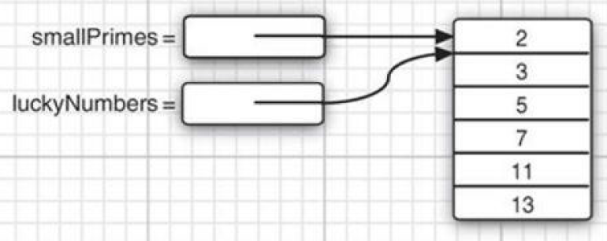

Slide 115
Command-Line Parameters
Every Java program has a main method with a String[] args parameter.
This parameter indicates that the main method receives an array of strings – the arguments specified on the command line.
public class Message
{
public static void main(String[] args)
{
if (args[0].equals("-h"))
System.out.print("Hello,");
else if (args[0].equals("-g"))
System.out.print("Goodbye,");
// print the other command-line arguments
for (int i = 1; i < args.length; i++)
System.out.print(" " + args[i]);
System.out.println("!");
}
}

Slide 116
If the program is called as
java Message -g cruel world
then the args array has the following contents:
args[0]: "-g"
args[1]: "cruel"
args[2]: "world"
The program prints the message
Goodbye, cruel world!

Slide 117
Array Sorting
To sort an array of numbers, you can use one of the sort methods in the Arrays class:
int[] a = new int[10000];
. . .
Arrays.sort(a)
This method uses a tuned version of the QuickSort algorithm that is claimed to be very efficient on most data sets.
The Arrays class provides several other convenience methods for arrays

Slide 118
Multidimensional Arrays
Multidimensional arrays use more than one index to access array elements.
They are used for tables and other more complex arrangements.
Declaring a two-dimensional array in Java is simple enough. For example:
double[][] balances;
As always, you cannot use the array until you initialize it with a call to new.
In this case, you can do the initialization as follows:
balances = new double[NYEARS][NRATES];

Slide 119
if you know the array elements, you can use a shorthand notation for initializing a
multidimensional array without a call to new. For example:
int[][] magicSquare =
{
{16, 3, 2, 13},
{5, 10, 11, 8},
{9, 6, 7, 12},
{4, 15, 14, 1}
};
Once the array is initialized, you can access individual elements by supplying two pairs of brackets -for example, balances[i][j].

Slide 120
int rows, columns;
int[][] Employees = new int[100][50];
for (rows = 0; rows < 100 ; rows++) {
for (columns = 0; columns < 50; columns++) {
Employees[rows][columns] = 1;
}
}
Matrix multiplication

Slide 121
A “for each” loop does not automatically loop through all elements in a two-dimensional array.
Instead, it loops through the rows, which are themselves one-dimensional arrays.
To visit all elements of a two-dimensional array a, nest two loops, like this:
for (double[] row : a)
for (double value : row)
do something with value

Slide 122
Ragged Arrays
Java has no multidimensional arrays at all, only one-dimensional arrays.
Multidimensional arrays are faked as “arrays of arrays.”
Since rows of arrays are individually accessible, you can actually swap them!
double[] temp = balances[i];
balances[i] = balances[i + 1];
balances[i + 1] = temp;

Slide 123
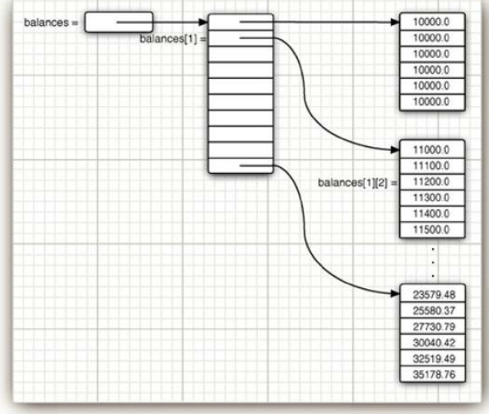

Slide 124
It is also easy to make “ragged” arrays—that is, arrays in which different rows have different lengths.
Let us make an array in which the element at row i and column j equals the number of possible outcomes of a “choose j numbers from i numbers” lottery.
      1
      1 1
      1 2 1
      1 3 3 1
      1 4 6 4 1
      1 5 10 10 5 1
      1 6 15 20 15 6 1
As j can never be larger than i, the matrix is triangular. The ith row has i + 1 elements.
To build this ragged array, first allocate the array holding the rows.
int[][] odds = new int[NMAX + 1][];
Next, allocate the rows.
for (int n = 0; n <= NMAX; n++)
odds[n] = new int[n + 1];

Slide 125
Objects and Classes

Slide 126
Introduction to Object-Oriented Programming
Object-oriented programming, or OOP for short, is the dominant programming paradigm these days, having replaced the “structured,” procedural programming techniques
Java is object-oriented.
An object-oriented program is made of objects.
Each object has a specific functionality, exposed to its users, and a hidden implementation.
Many objects in your programs will be taken “off-the-shelf” from a library; others will be custom-designed.

Slide 127
Traditional structured programming consists of designing a set of procedures (or algorithms) to solve a problem.
Once the procedures are determined, the traditional next step was to find appropriate ways to store the data.
Algorithms + Data Structures = Programs
Algorithms come first, and data structures come second.
OOP reverses the order: puts the data first, then looks at the algorithms to operate on the data.
For small problems, the breakdown into procedures works very well. But objects are more appropriate for larger problems.

Slide 128
Classes
A class is the template or blueprint from which objects are made.
When you construct an object from a class, you are said to have created an instance of the class.
All code that you write in Java is inside a class.
The standard Java library supplies several thousand classes for such diverse purposes as user interface design, dates and calendars, and network programming.
But sometimes, in Java you still have to create your own classes to describe the objects of your application’s problem domain.

Slide 129
Encapsulation (sometimes called information hiding) is a key concept in working with objects.
Encapsulation is simply combining data and behavior in one package and hiding the implementation details from the users of the object.
The data in an object are called its instance fields, and the procedures that operate on the data are called its methods.
A specific object that is an instance of a class will have specific values of its instance fields.
The set of those values is the current state of the object.
Whenever you invoke a method on an object, its state may change.

Slide 130
The key to making encapsulation work is to have methods never directly access instance fields in a class other than their own.
Programs should interact with object data only through the object’s methods.
Encapsulation is the key to reuse and reliability.
Classes can be built by extending other classes.
Java, in fact, comes with a “cosmic superclass” called Object.
All other classes extend this class.
When you extend an existing class, the new class has all the properties and methods of the class that you extend.
You then supply new methods and data fields that apply to your new class only.
The concept of extending a class to obtain another class is called inheritance.

Slide 131
Objects
To work with OOP, you should be able to identify three key characteristics of objects:
  The object’s behavior—What can you do with this object, or what methods can you apply to it?
  The object’s state—How does the object react when you invoke those methods?
  The object’s identity—How is the object distinguished from others that may have the same behavior and state?

Slide 132
All objects that are instances of the same class share the same behavior.
The behavior of an object is defined by the methods that you can call.
Next, each object stores information about what it currently looks like. This is the object’s state.
An object’s state may change over time, but not spontaneously. A change in the state of an object must be a consequence of method calls. (If an object’s state changed without a method call on that object, someone broke encapsulation.)
However, the state of an object does not completely describe it, because each object has a distinct identity.
For example, in an order processing system, two orders are distinct even if they request identical items.
Notice that the individual objects that are instances of a class always differ in their identity and usually differ in their state.

Slide 133
These key characteristics can influence each other.
For example, the state of an object can influence its behavior.
Eg: If an order is “shipped” or “paid,” it may reject a method call that asks it to add or remove items.
Conversely, if an order is “empty”—that is, no items have yet been ordered—it should not allow itself to be shipped.

Slide 134
Identifying Classes
In a traditional procedural program, you start the process at the top, with the main function.
For OOP, identify your classes and then add methods to each class.
A simple rule of thumb in identifying classes is to look for nouns in the problem analysis. Methods, correspond to verbs.
For example, in an order-processing system, some of the nouns are
    • Item
    • Order
    • Shipping address
    • Payment
    • Account
These nouns may lead to the classes Item, Order, and so on.

Slide 135
Next, look for verbs. Items are added to orders. Orders are shipped or canceled.
Payments are applied to orders. With each verb, such as “add,” “ship,” “cancel,” or “apply,” you identify the object that has the major responsibility for carrying it out.

Slide 136
Relationships between Classes
The most common relationships between classes are
  Dependence (“uses–a”)
  Aggregation (“has–a”)
  Inheritance (“is–a”)
The dependence, or “uses–a” relationship, is the most obvious and also the most general.
For example, the Order class uses the Account class because Order objects need to access Account objects to check for credit status.
But the Item class does not depend on the Account class, because Item objects never need to worry about customer accounts.
Thus, a class depends on another class if its methods use or manipulate objects of that class.

Slide 137
T he aggregation, or “has–a” relationship, is easy to understand because it is concrete;
For example, an Order object contains Item objects. Containment means that objects of class A contain objects of class B.
The inheritance, or “is–a” relationship, expresses a relationship between a more special and a more general class.
For example, a RushOrder class inherits from an Order class.
The specialized RushOrder class has special methods for priority handling and a different method for computing shipping charges, but its other methods, such as adding items and billing, are inherited from the Order class.
In general, if class A extends class B, class A inherits methods from class B but has more capabilities.

Slide 138

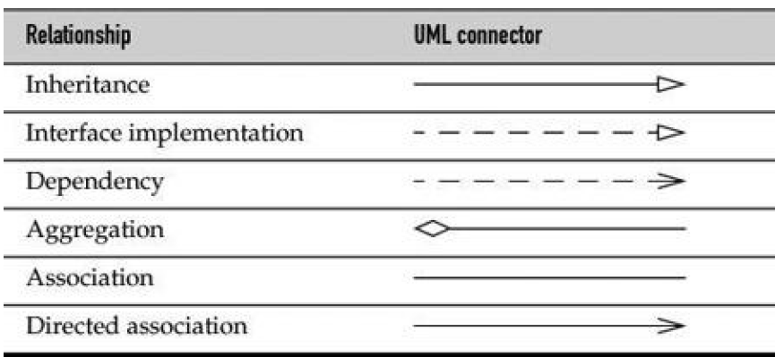
Many programmers use the UML (Unified Modeling Language) notation to draw class diagrams that describe the relationships between classes.

Slide 139
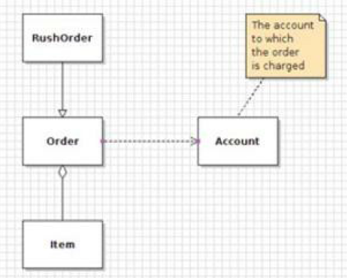
A class diagram

Slide 140
Using Predefined Classes

Slide 141
Objects and Object Variables
To work with objects, first construct them and specify their initial state and then apply methods to the objects.
Use constructors to construct new instances.
A constructor is a special method whose purpose is to construct and initialize objects.
Constructors always have the same name as the class name.
The standard Java library contains a Date class.
Thus, the constructor for the Date class is called Date.
To construct a Date object, you combine the constructor with the new operator, as follows:
new Date()
This expression constructs a new object. The object is initialized to the current date and time.
    System.out.println(new Date());
    String s = new Date().toString();
    Date birthday = new Date();

Slide 142
There is an important difference between objects and object variables. For example, the statement
Date deadline; // deadline doesn't refer to any object
defines an object variable, deadline, that can refer to objects of type Date.
It is important to realize that the variable deadline is not an object
You cannot use any Date methods on this variable at this time. s = deadline.toString(); // cannot be used now
would cause a compile-time error.
You must first initialize the deadline variable.
Initialize the variable with a newly constructed object:
deadline = new Date();
Or you can set the variable to refer to an existing object:
deadline = birthday;
Now both variables refer to the same object

Slide 143
An object variable doesn’t actually contain an object. It only refers to an object.
In Java, the value of any object variable is a reference to an object that is stored elsewhere.
The return value of the new operator is also a reference.
Date deadline = new Date();
has two parts. The expression new Date() makes an object of type Date, and its value is a reference to that newly created object.
That reference is then stored in the deadline variable.
You can explicitly set an object variable to null to indicate that it currently refers to no object.
deadline = null;
. . .
if (deadline != null)
System.out.println(deadline);

Slide 144
If you apply a method to a variable that holds null, a runtime error occurs.
birthday = null;
String s = birthday.toString(); // runtime error!
Local variables are not automatically initialized to null.
You must initialize them, either by calling new or by setting them to null.
Java object variables as analogous to object pointers in C++.
Date birthday; // Java
is the same as
Date* birthday; // C++

Slide 145
The GregorianCalendar Class of the Java Library
The standard Java library contains two separate classes:
Date class - which represents a point in time, and
GregorianCalendar class - which expresses dates in the familiar calendar notation.
GregorianCalendar class extends a more generic Calendar class that describes the properties of calendars in general.
The Date class has only a small number of methods that allow you to compare two points in time.
For example, the before and after methods tell you if one point in time comes before or after another:
if (today.before(birthday))
System.out.println("Still time to shop for a gift.");

Slide 146
Date class has another three methods getDay, getMonth, and getYear
The GregorianCalendar class has many more methods than the Date class.
The expression
new GregorianCalendar()
constructs a new object that represents the date and time at which the object was constructed.
You can construct a calendar object for midnight on a specific date by supplying year, month, and day:
new GregorianCalendar(1999, 11, 31)
For greater clarity, there are constants like Calendar.DECEMBER:
new GregorianCalendar(1999, Calendar.DECEMBER, 31)
You can also set the time:
new GregorianCalendar(1999, Calendar.DECEMBER, 31, 23, 59, 59)

Slide 147
To query date, weekday, month, or year, of a certain point in time, use the get method of the GregorianCalendar class.
To select the item that you want to get, pass a constant defined in the Calendar class, such as Calendar.MONTH or Calendar.DAY_OF_WEEK:
GregorianCalendar now = new GregorianCalendar();
int month = now.get(Calendar.MONTH);
int weekday = now.get (Calendar.DAY_OF_WEEK);

Slide 148
To change the state, call the set method:
deadline.set(Calendar.YEAR, 2001);
deadline.set(Calendar.MONTH, Calendar.APRIL);
deadline.set(Calendar.DAY_OF_MONTH, 15);
There is also a convenience method to set the year, month, and day with a single call:
deadline.set(2001, Calendar.APRIL, 15);
Finally, you can add a number of days, weeks, months, and so on, to a given calendar object:
deadline.add(Calendar.MONTH, 3);
// move deadline by 3 months
If you add a negative number, then the calendar is moved backwards.

Slide 149
A common convention is to prefix accessor methods with the prefix get and mutator methods with the prefix set.
For example, the GregorianCalendar class has methods getTime and setTime that get and set the point in time that a calendar object represents:
Date time = calendar.getTime();
calendar.setTime(time);
These methods are particularly useful for converting between the GregorianCalendar and Date classes.

Slide 150
Defining Your Own Classes
The classes in JAVA need not have a main method.
Instead, they have their own instance fields and methods.
To build a complete program, you combine several classes, one of which has a main method.

Slide 151
The simplest form for a class definition in Java is
    class ClassName
    {
    field1
    field2
    . . .
    constructor1
    constructor2
    . . .
    method1
    method2
    . . .
    }

Slide 152
class Employee
{ // instance fields
private String name;
private double salary;
private Date hireDay;
// constructor
public Employee(String n, double s, int year, int month, int day)
{ name = n;
salary = s;
GregorianCalendar calendar = new GregorianCalendar(year, month - 1,
day);
hireDay = calendar.getTime(); }
// a method
public String getName()
{ return name; }
// more methods
. . . }

Slide 153
import java.util.*;
public class EmployeeTest
{
public static void main(String[] args)
{
// fill the staff array with three Employee objects
Employee[] staff = new Employee[3];
staff[0] = new Employee("Carl Cracker", 75000, 1987, 12, 15);
staff[1] = new Employee("Harry Hacker", 50000, 1989, 10, 1);
staff[2] = new Employee("Tony Tester", 40000, 1990, 3, 15);
// raise everyone's salary by 5%
for (Employee e : staff)
e.raiseSalary(5);
// print out information about all Employee objects
for (Employee e : staff)
System.out.println("name=" + e.getName() + ",salary=" +
e.getSalary() + ",hireDay="
+ e.getHireDay());
}
}

Slide 154
;
For(int i=0;……) { }
For( int i=0;…) { }

Slide 155
class Employee
{
private String name;
private double salary;
private Date hireDay;
public Employee(String n, double s, int year, int month, int day)
{
name = n;
salary = s;
GregorianCalendar calendar = new GregorianCalendar(year, month -
1, day);
// GregorianCalendar uses 0 for January
hireDay = calendar.getTime();
}
public String getName()
{ return name; }
public double getSalary()
{ return salary; }
public Date getHireDay()
{ return hireDay; }
public void raiseSalary(double byPercent)
{ double raise = salary * byPercent / 100;
salary += raise; }
}

